Slide 1
Private-Key Encryption Part 2

Slide 2
Last Time
Encryption as a tool for confidentiality
Private-Key Encryption
Also known as Symmetric-Key Encryption
Same key for both encryption & decryption

Slide 3
Recap: Private-Key Encryption
Encryption
Decryption
Key
Plaintext
Enc
Ciphertext
Key
Plaintext
Dec
Ciphertext

Slide 4
Recap: Private-Key Encryption
Encryption
Decryption
K
M
E
C = E_{K}(M)
K
M = D_{K}(C)
D
C

Slide 5
Last Time
Insecure ciphers
Shift (Caesar) cipher
Substitution cipher
Ciphertext yields lots of patterns of the plaintext

Slide 6
Last Time
Shannon’s of perfect secrecy
The ciphertext E_{K}(M) has no statistical correlation with the plaintext M
I.e. for any ciphertext, its plaintext is equally likely to be any possible message
Thus the ciphertext contains no information about the plaintext

Slide 7
Last Time
Perfect secrecy implies security against unbounded attackers
Since the ciphertext contains no information about the plaintext
Even exhausting all possible keys does not help

Slide 8
Last Time
One-time pad encryption
Based on XOR of message & one-time pad
Message & one-time pad are of equal length

Slide 9
Today
The security & limitations of one-time pad
Shannon’s impossibility result & implications
Overview of modern private-key encryption

Slide 10
The Security of One-time Pad
One-time Pad encryption satisfies perfect secrecy if the one-time pad is randomly generated and used once
For any ciphertext, every message of the same length is equally likely to be its plaintext
10
Notes:
10

Slide 11
Example
Suppose that 01 is the ciphertext. What can its plaintext be?
The plaintext can be
00 if K = 01
01 if K = 00
10 if K = 11
11 if K = 10
Each of the 4 possibilities occurs with probability ¼

Slide 12
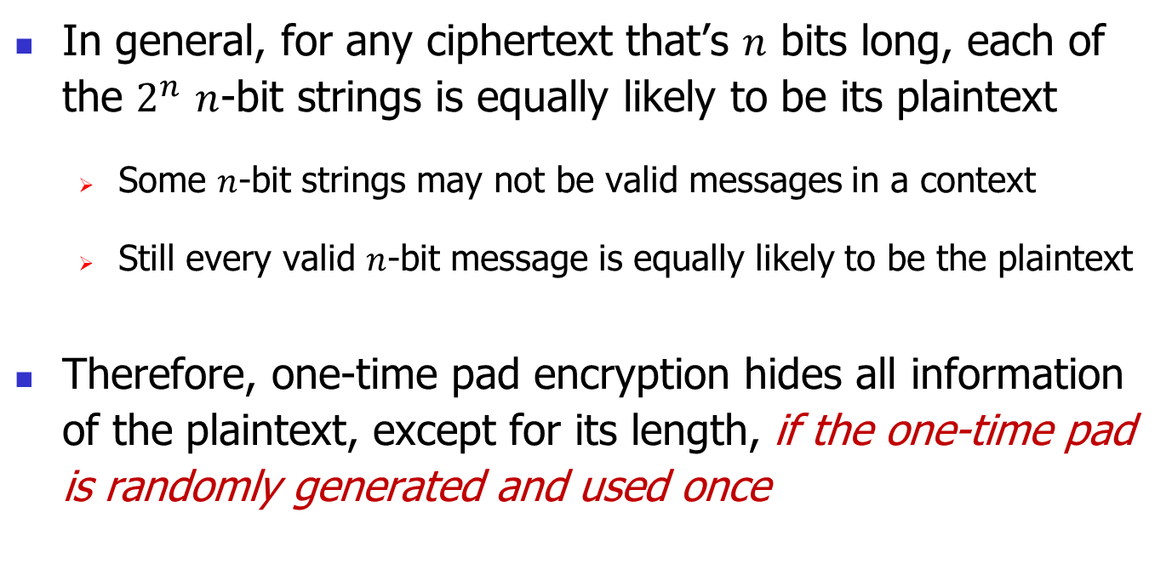
The Security of One-time Pad
In general, for any ciphertext that’s $n$ bits long, each of the $2^{n}$ $n$-bit strings is equally likely to be its plaintext
Some $n$-bit strings may not be valid messages in a context
Still every valid $n$-bit message is equally likely to be the plaintext
Therefore, one-time pad encryption hides all information of the plaintext, except for its length, if the one-time pad is randomly generated and used once
12
Notes:
12

Slide 13
Limitations of One-Time Pad
One-time pad can be used only once
Perfect secrecy no longer holds if the one-time pad is used twice
Re-using the one-time pad a few times leads to total break
Thus need to establish a new key for each message
Key is long
Size of One-time Pad = Size of Message

Slide 14
Remark One-Time Pad
Despite the limitations, one-time pad remains a fundamental building block in the constructions of modern encryption schemes

Slide 15
Question: Can we construct a private-key encryption scheme with a short, reusable key that satisfies Shannon’s perfect secrecy?

Slide 16
Shannon’s Impossibility Result
To achieve perfect secrecy, the entropy of the key must be at least as large as that of the plaintext, i.e.
The number of random bits in the key must be at least as large as the number of plaintext bits encrypted
In particular, the key must be at least as long as the message
Key is not reusable
Thus One-Time Pad is the best possible

Slide 17
Implications
Perfect secrecy is unrealistic
Security can be practically achieved only if the attacker is limited in some way

Slide 18
Modern Approach to Security
Choose a hard puzzle that no one knows how to solve using the state-of-the-art technology
Build a system based on the hard puzzle, so that to break the system one must solve the puzzle
The system remains secure relative to an attacker as long as the attacker cannot solve the puzzle

Slide 19
Modern Private-Key Encryption
Goals:
A short (say 256-bit) key re-usable for encrypting many long messages (say gigabytes long)
Hard for an attacker to learn information about the encrypted messages
Hard means breaking the encryption requires an inordinate amount of resources, or a technology that’s not yet available

Slide 20
Overview of Modern Private-Key Encryption

Slide 21
Types of Modern Cipher
Stream Cipher (e.g. RC4, ChaCha)
Block Cipher (e.g. AES)

Slide 22
Block Cipher vs. Stream Cipher
Stream ciphers are faster
But block ciphers are usually more secure, and therefore more often used
22
Notes:
22

Slide 23
Stream Cipher

Slide 24
Stream Cipher
Based on one-time pad encryption
Uses a pseudorandom generator (PRG) to generate a one-time pad for every message
The output by the PRG, also known as the keystream, is XORed with the message

Slide 25
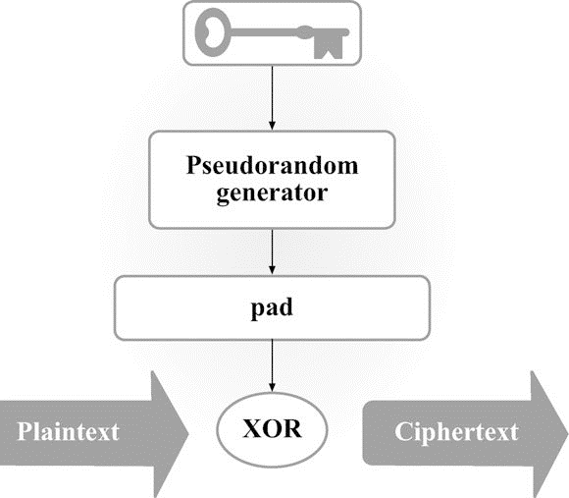
Stream Cipher Overview (Figure from Katz & Lindell)

Slide 26
Pseudorandom Generator
A PRG is a function that
Takes a short random seed (key) as input
Outputs as many bits as needed on demand
At the core of a stream cipher & where its complexity is
Different stream ciphers differ only in how PRG is constructed
Construction complicated & omitted

Slide 27
A Note on Security
The keystream output by PRG is pseudorandom but not truly random
Key length << keystream length = message length
Thus key space is negligibly small compared to the message space

Slide 28
A Note on Security
An unbounded attacker can break the scheme by brute force (as one breaks shift cipher):
Try all possible keys
For each key, use the resulting keystream to decrypt the captured ciphertext into a plaintext
Pick the plaintext that is the most relevant in the context
This attack however requires an infeasible amount of resources even for a small key (say 128 bits)

Slide 29
Some Practical Attacks
Reused-key attack
Cause the same keystream (one-time pad) to be generated and reused to encrypt multiple messages
E.g. Birthday Attack
Details omitted
Bit-flipping attack
Will address this when we discuss integrity

Slide 30
Some Popular Stream Ciphers
RC4
Was used in SSL/TLS (to protect Internet traffic) and in WEP & WPA (to secure wireless networks)
Many insecure versions were broken & led to insecure protocols, such as WEP
A5/1
Used for GSM cellphone encryption
Not secure – has been routinely decrypted by NSA

Slide 31
Some Popular Stream Ciphers
ChaCha
Becoming the most widely used stream cipher
ChaCha20 used in TLS
Google uses ChaCha20 to secure the communication between Chrome browsers on Android and Google’s websites
ChaCha20 now also used in OpenSSH & many other systems

Slide 32
Next: Block Cipher

